Slide 1

TRAFFIC JAM PROJECT
By Niels Blonk, Danny Bui, Laura Holtus, Marc de Jong, David Koymans, Daan de Munck, Ravan Strijker and Elio Verhoef

Slide 2




The ‘problem’
Jams and car crashes
Traffic estimation
Varying rules
How does the future look?

Slide 3



The solution
Traffic simulation
Existing software
Our take

Slide 4
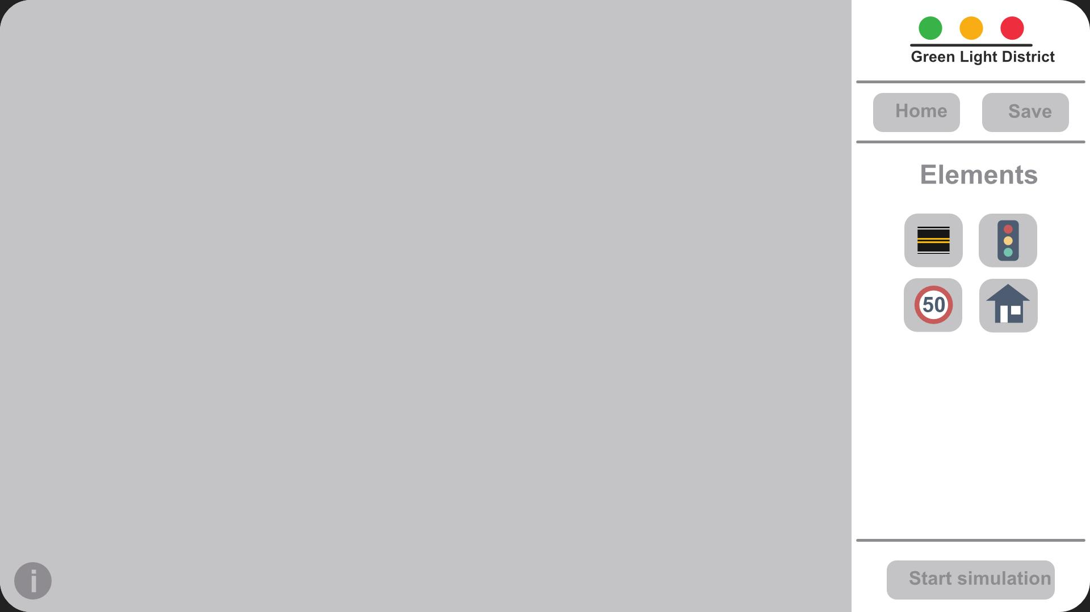
Project goals
Building road junctions
Realistic simulations
Car types
Driver behavior
Traffic rules

Slide 5
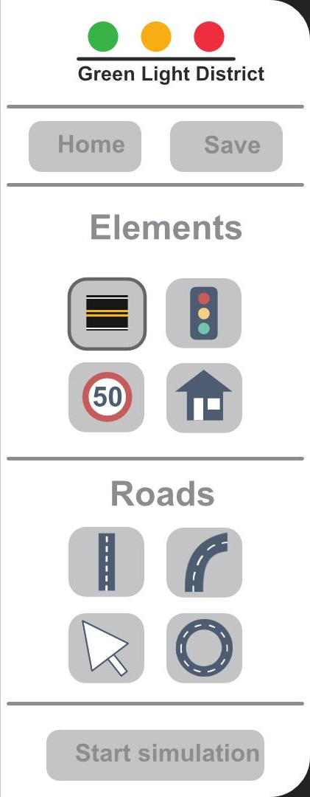
Project goals
Building road junctions
Realistic simulations
Car types
Driver behavior
Traffic rules

Slide 6
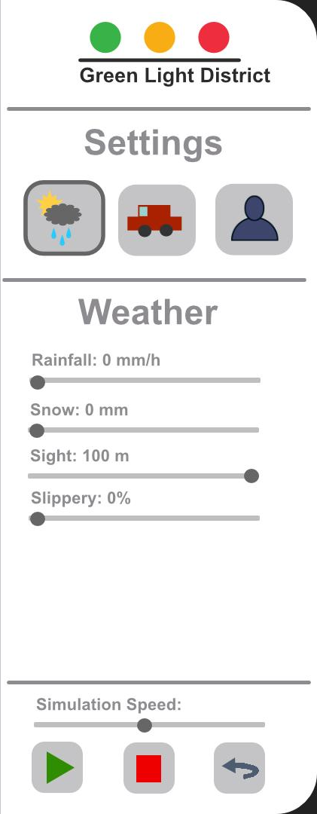
Project goals
Building road junctions
Realistic simulations
Car types
Driver behavior
Traffic rules

Slide 7
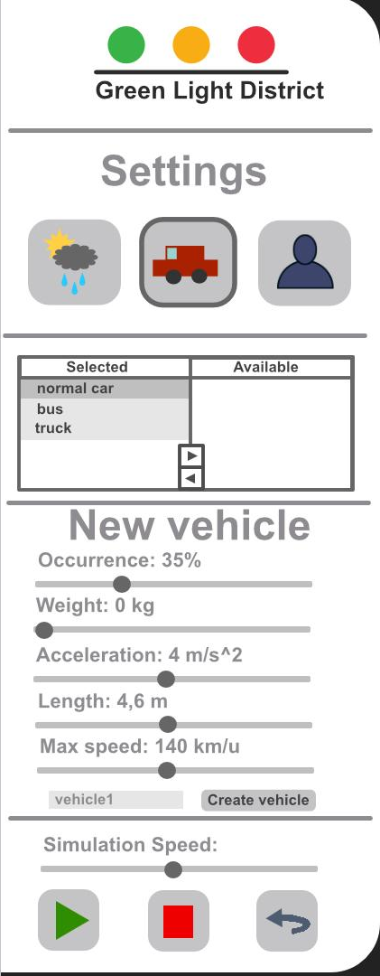
Project goals
Building road junctions
Realistic simulations
Car types
Driver behavior
Traffic rules

Slide 8
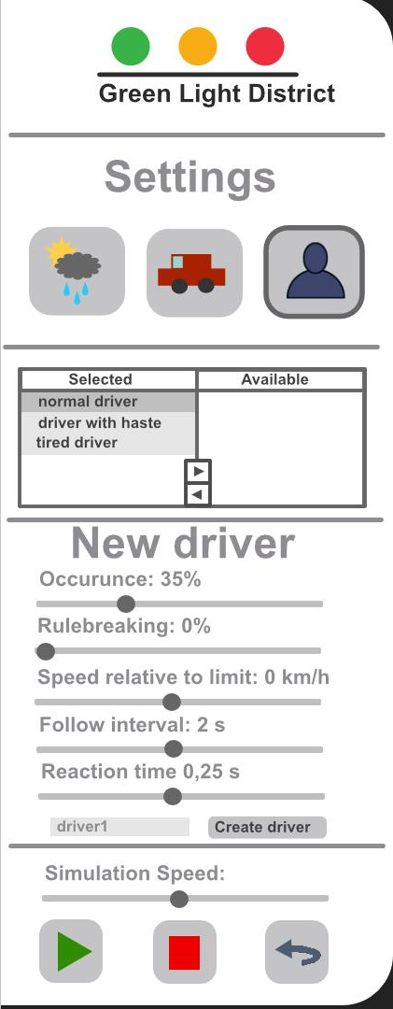
Project goals
Building road junctions
Realistic simulations
Car types
Driver behavior
Traffic rules

Slide 9
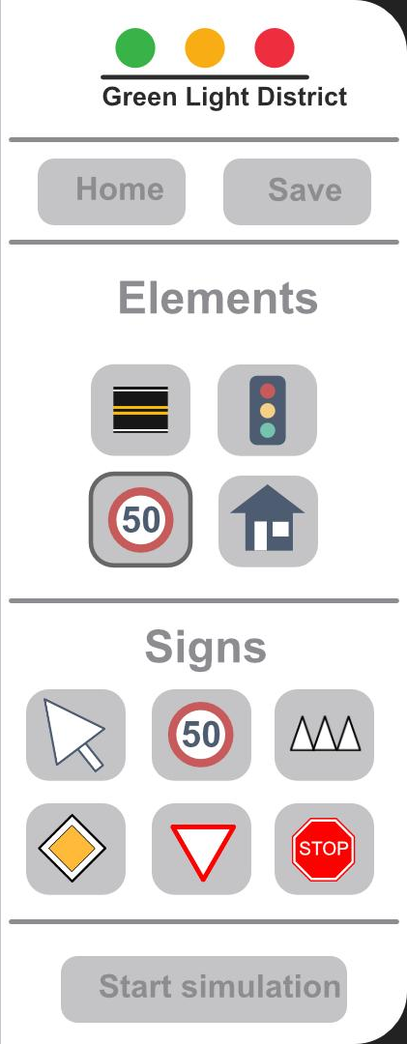
Project goals
Building road junctions
Realistic simulations
Car types
Driver behavior
Traffic rules

Slide 10
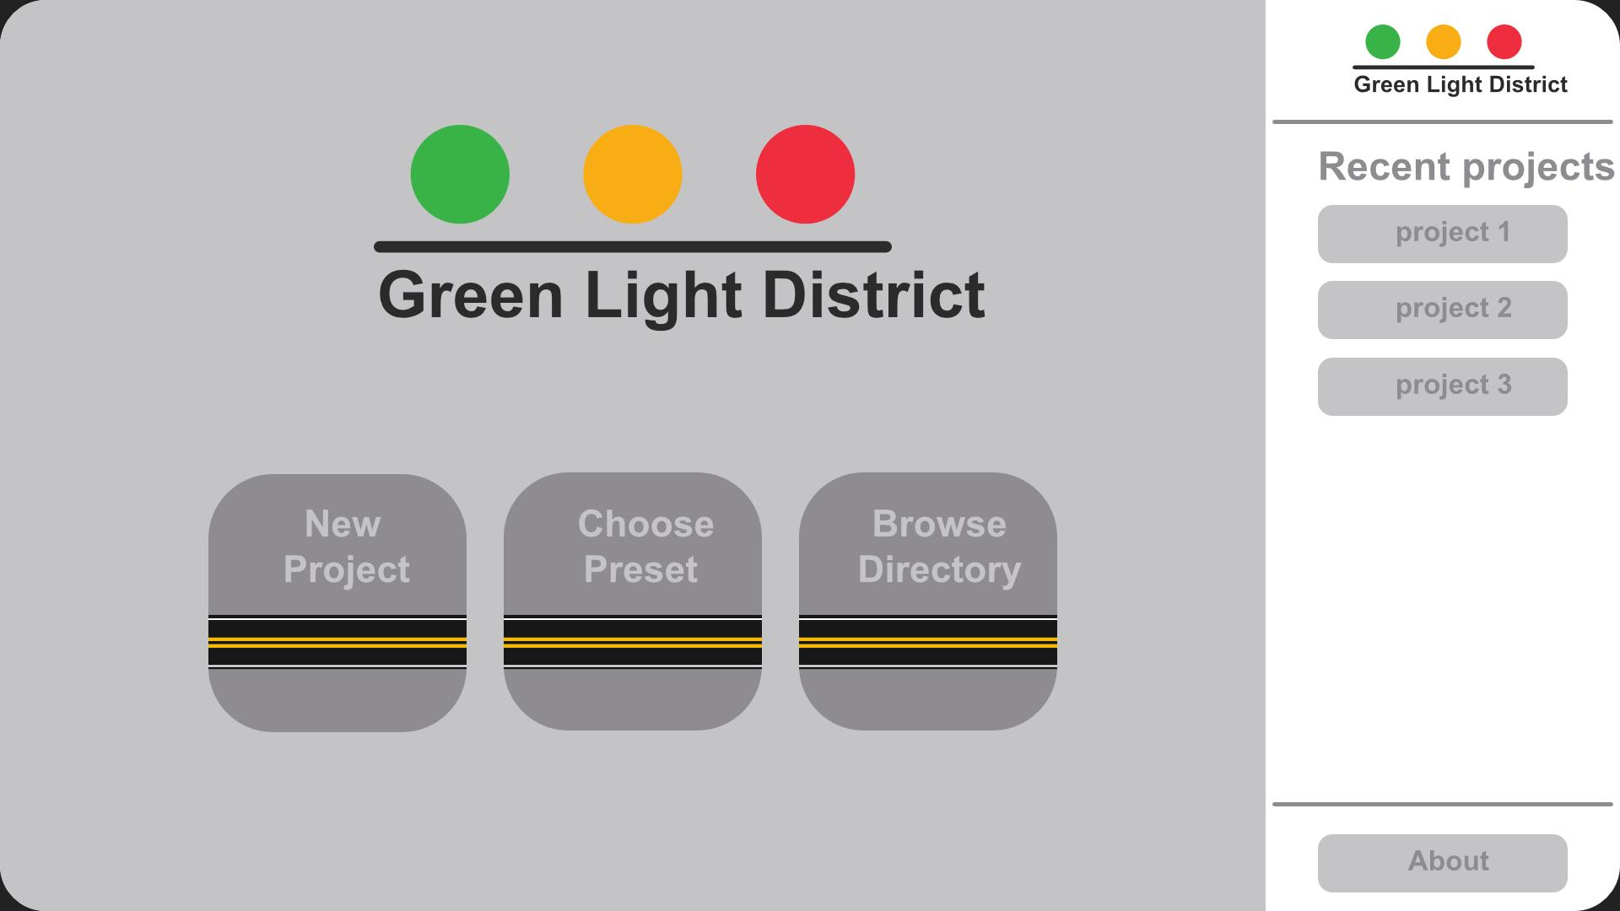
Presets and saving

Slide 11
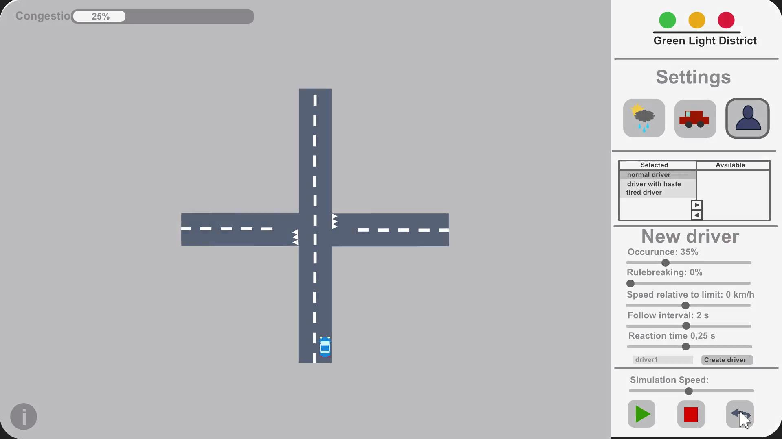
What our program will look like

Slide 12
Questions?

